Slide 1
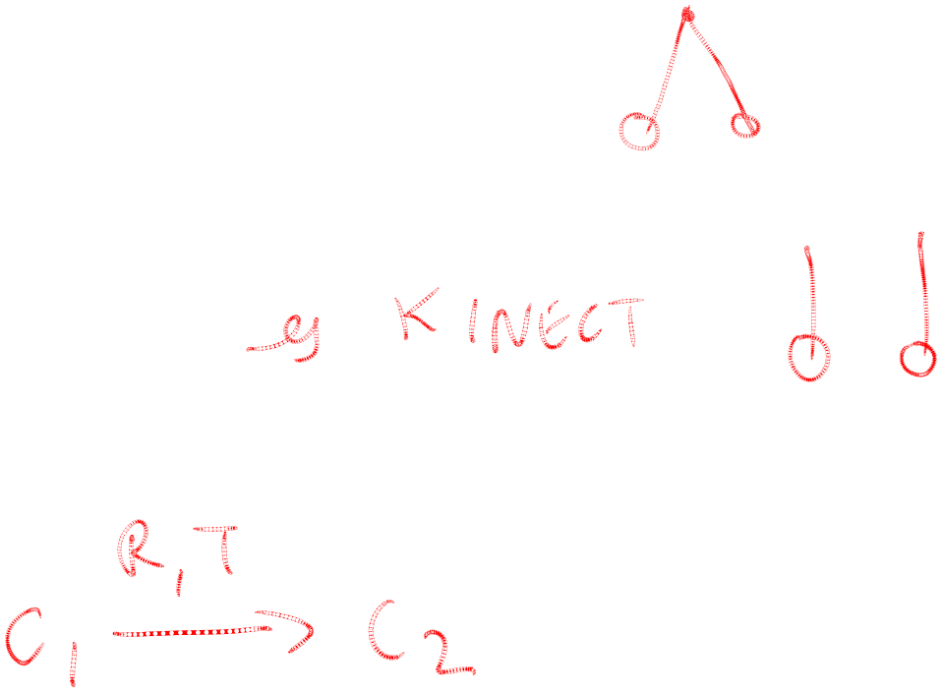
Various camera configurations
Single point of fixation where optical axes intersect
Optical axes parallel (fixation at infinity)
General case

Slide 2

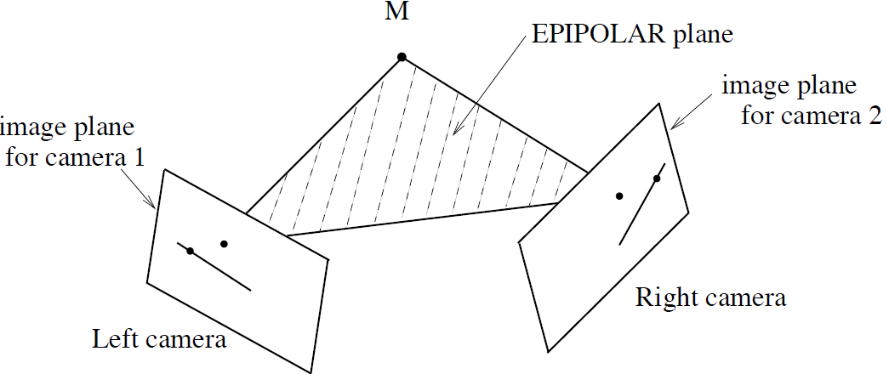
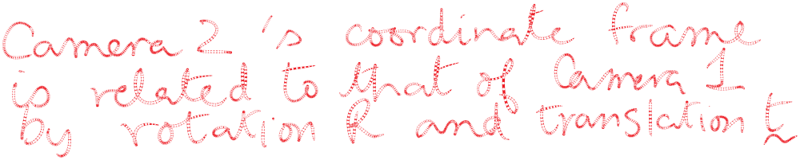
Epipolar geometry for cameras in general position

Slide 3
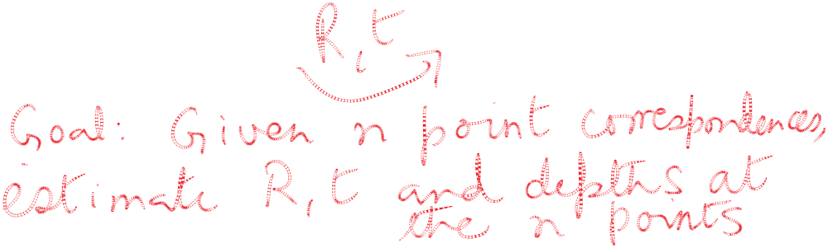
Epipolar geometry for cameras in general position

Slide 4

Applications
Reconstructing a three dimensional object given two or more photos. The relative orientation of the cameras is unknown, such as when using images downloaded from the internet, taken by different people at different times.
Some examples from Univ. Washington/Microsoft Research:
  phototour.cs.washington.edu
  photosynth.net
  grail.cs.washington.edu/rome/

Slide 5
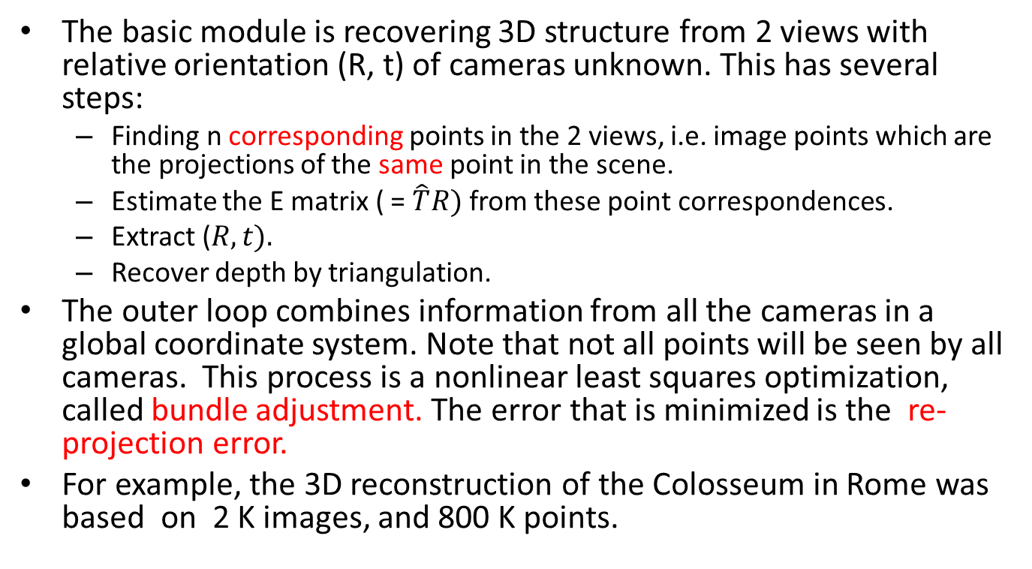
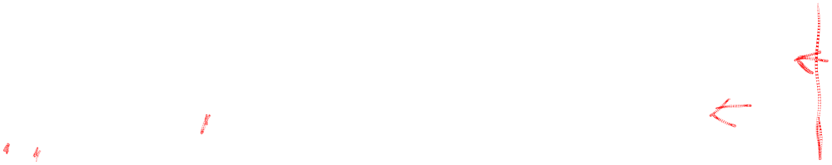
The approach

Slide 6

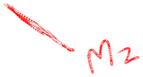



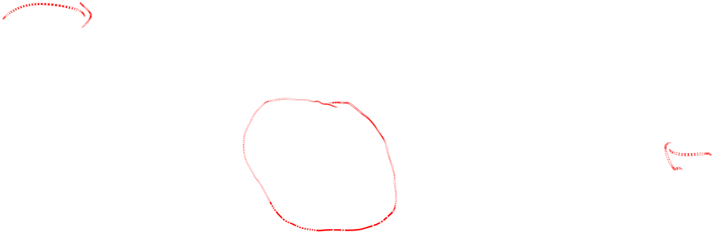
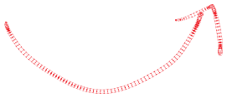
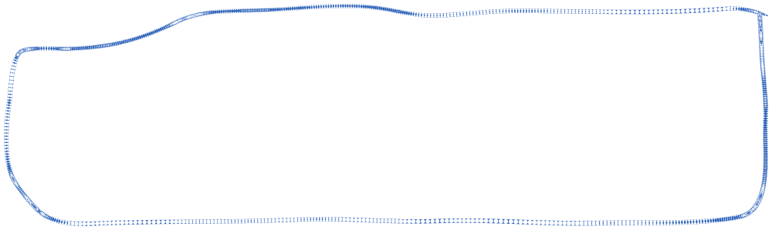
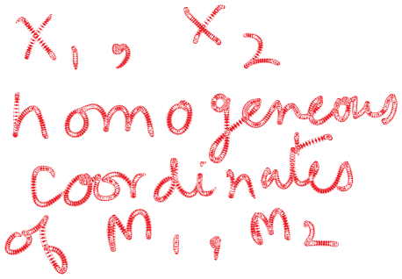
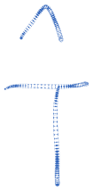
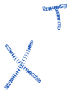
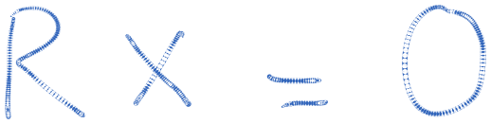

The Essential Matrix Constraint

Slide 7
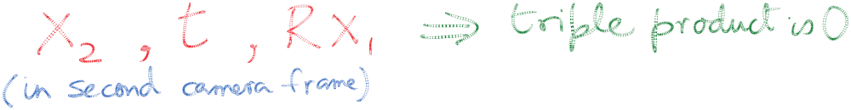
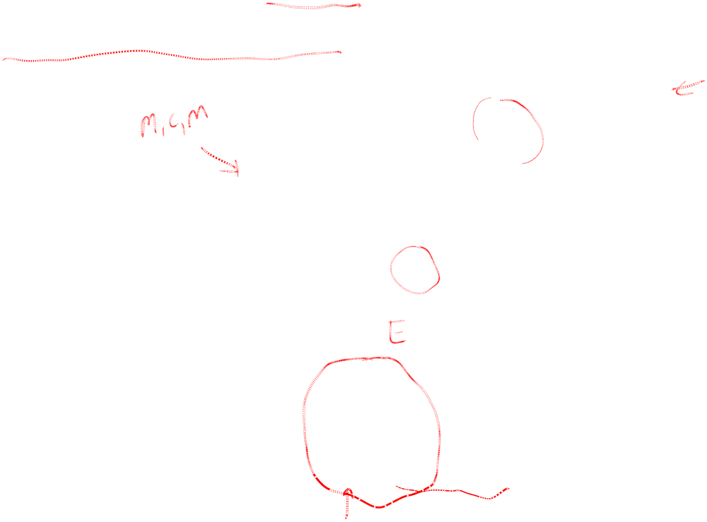
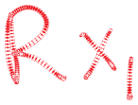


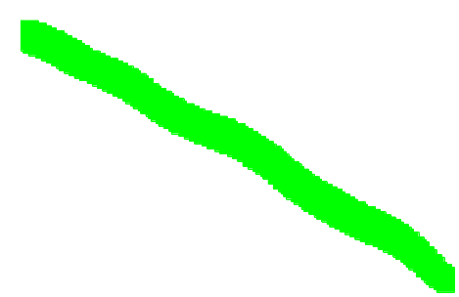
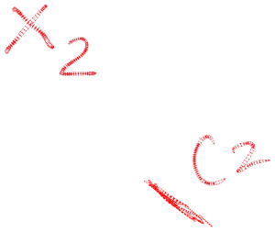


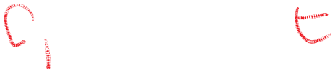
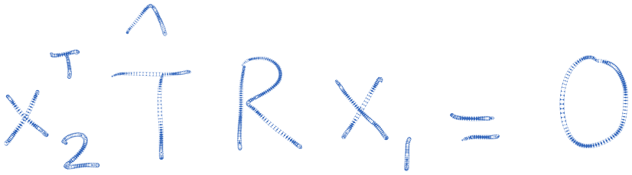
Proof is based on the co-planarity of three rays

Slide 8
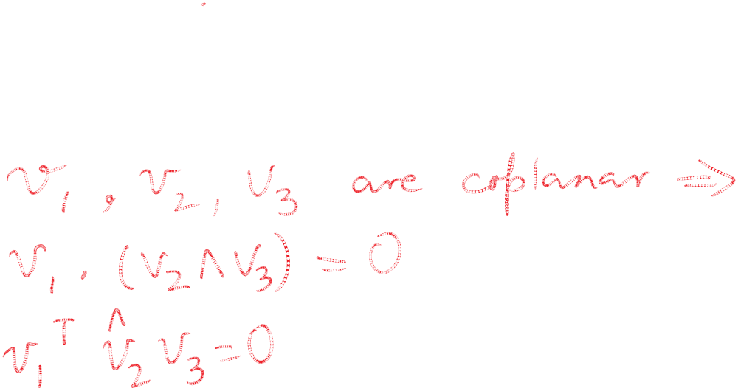
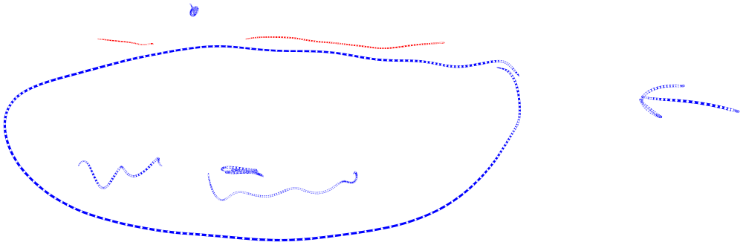
Coplanarity of 3-vectors implies triple product is zero

Slide 9
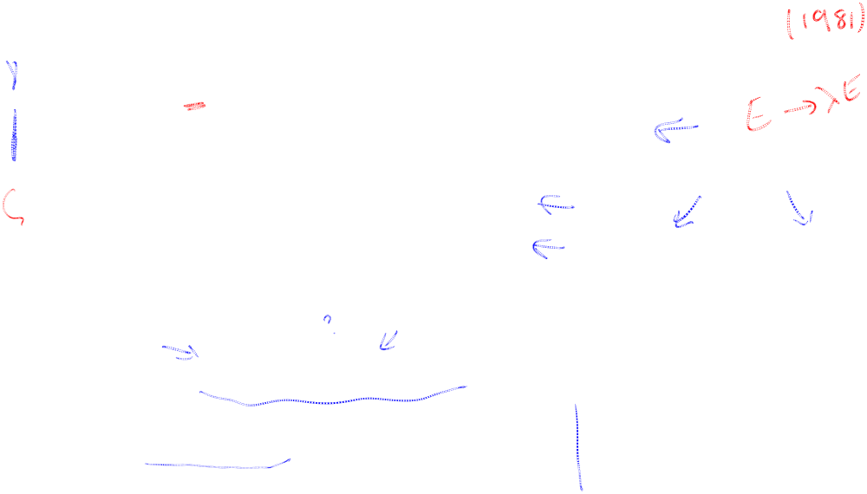
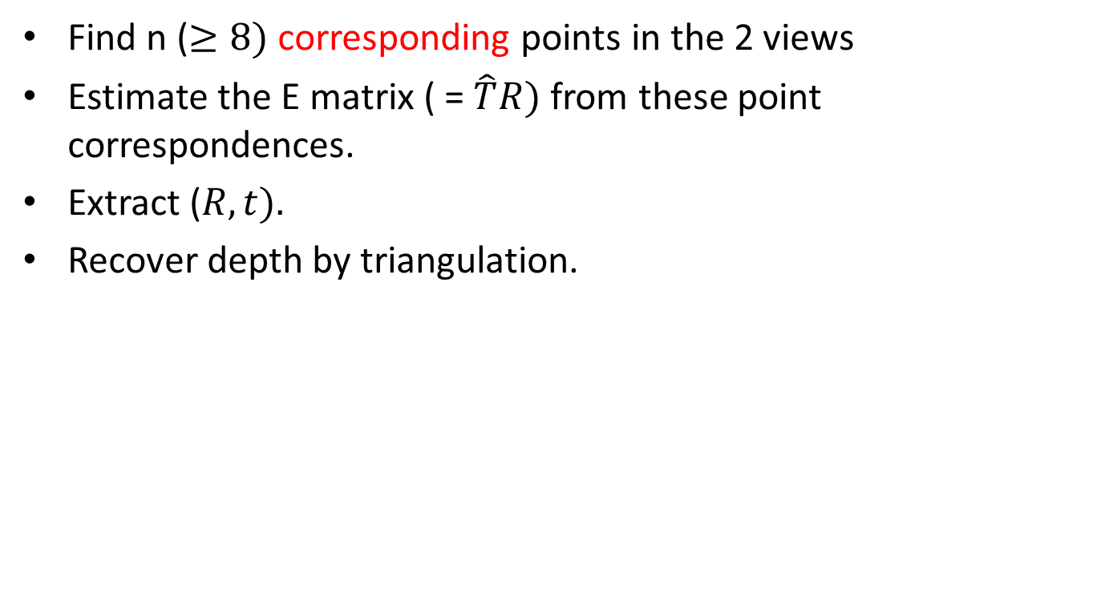
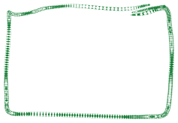
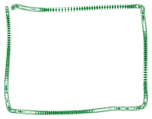
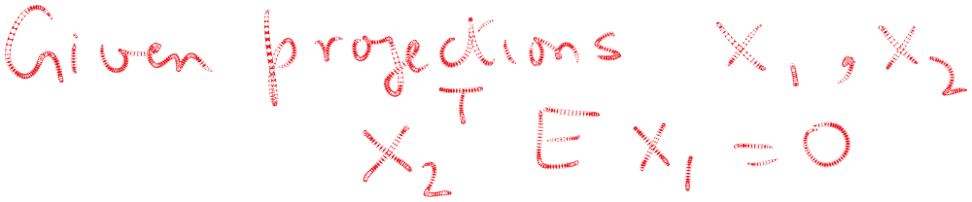


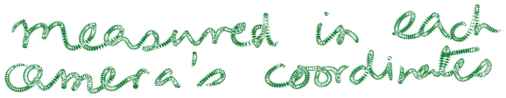






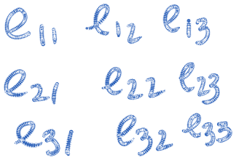

Longuet-Higgins 8 point algorithm

Slide 10

Summary
The basic module of recovering 3D structure from 2 views with relative orientation (R, t) of cameras unknown can be implemented using the Longuet-Higgins 8 point algorithm.
The outer loop combines information from all the cameras in a global coordinate system using bundle adjustment. The error that is minimized is the re-projection error. The big idea is that given the guessed 3d positions of a point, one can predict image plane 2d positions in any camera where it is visible. We wish to minimize the squared error between this predicted position and the actual position, summed over all cameras and over all points.
Lots of engineering has gone into making these approaches work. Read Szeliski’s book, Chapter 7, for more.

Slide 11
Epipolar geometry for cameras in general position

Slide 12
Epipolar geometry for cameras in general position

